Slide 1

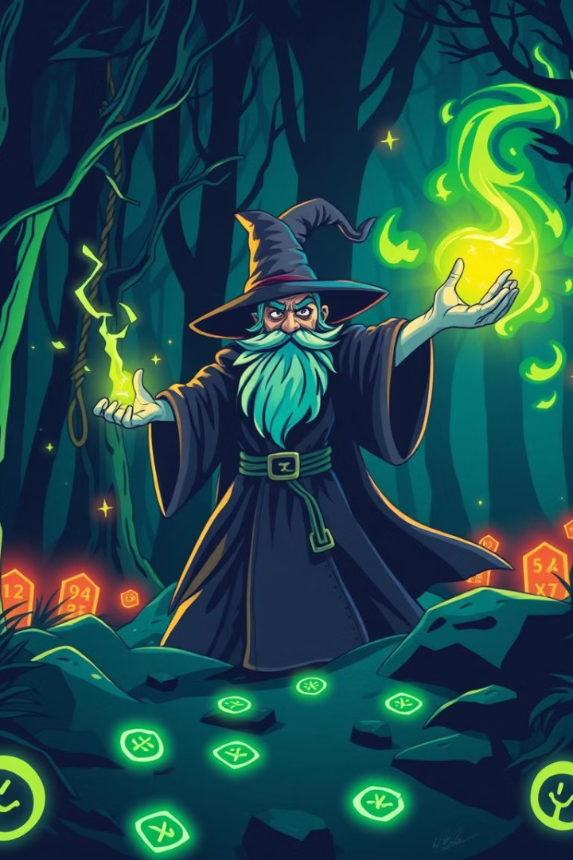
AI Dungeon Master:
An Interactive Storytelling Chatbot
Welcome to the presentation of AI Dungeon Master, an innovative chatbot that utilizes Large Language Models (LLMs) for dynamic storytelling. This presentation covers the system architecture, the role of LLMs, memory retention, and user interactions, highlighting the potential of AI in creating compelling narrative experiences.
by Dushyant Singh
2022181
Notes:
1

Slide 2
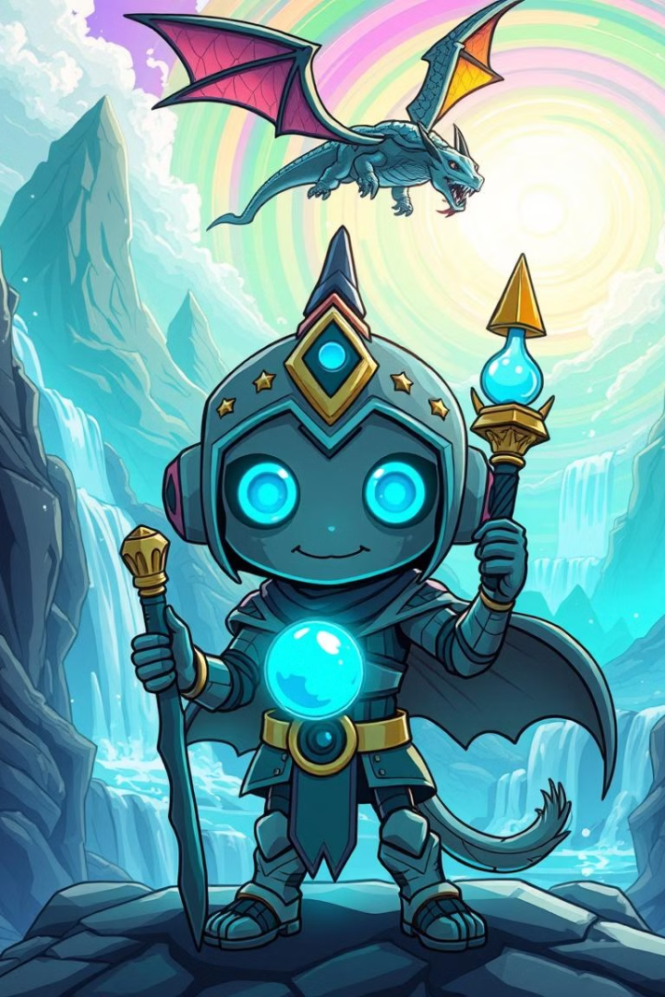
What is AI Dungeon Master?
The AI Dungeon Master is a chatbot that generates dynamic, interactive storytelling experiences. It allows users to influence the story through choices and custom inputs, creating an evolving adventure. This is achieved using a combination of Large Language Models (LLMs), vector databases for memory, and Flask for API interactions.
AI-driven storytelling with dynamic branching narratives
Memory retention for continuity using ChromaDB
User interactions through predefined choices and free text input
Real-time responses using Google's Gemini AI model
Notes:
2

Slide 3

Demo Walkthrough
Notes:
2

Slide 4
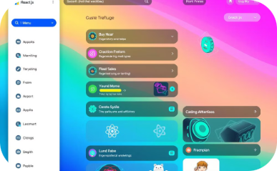
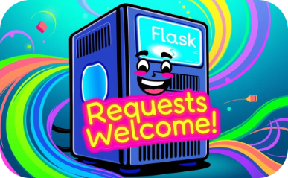
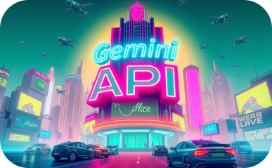

System Architecture
Frontend
Backend
LLM (Gemini 1.5 Flash)
Vector Database (ChromaDB)
Interactive UI built with React.js.
Flask server for handling user inputs and story generation.
Generates story segments and choices dynamically.
Stores and retrieves past interactions for story coherence.
Notes:
3

Slide 5
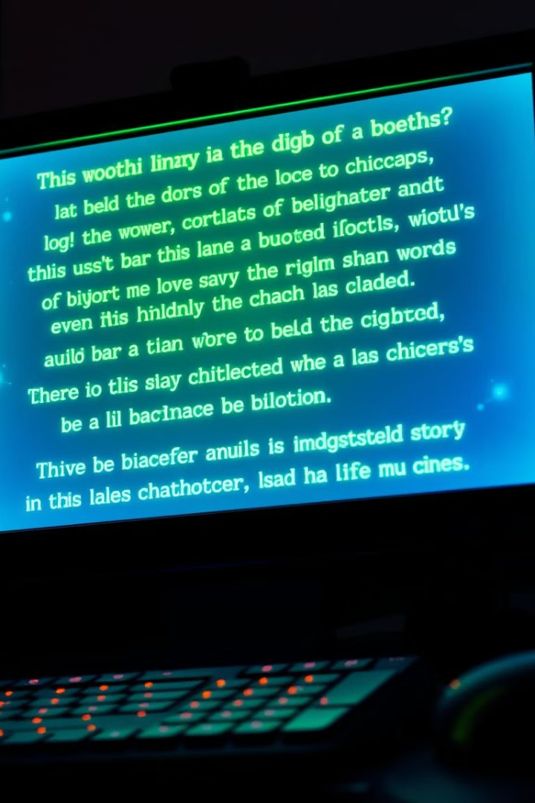
Frontend - React UI
1. Story Display
Uses useState to manage the displayed story.
Dynamically updates as new story segments are received.
2. User Interaction Components
Choices: Rendered as buttons. Clicking a button updates the selected choice.
Free Input Field: Users can type custom responses for more flexibility.
Submit Button: Triggers API call to Flask backend via Axios.
3. Visual Styling Enhancements
Story text styled with glowing effects for a fantasy-like feel.
Responsive layout for mobile and desktop users.
Notes:
4

Slide 6
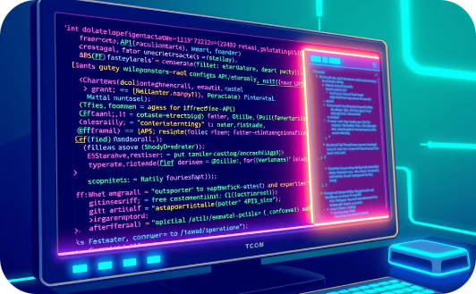

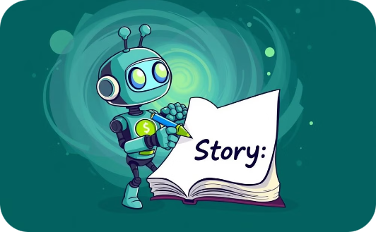
Implementation - Backend (Flask API)
Flask App & API Configuration
Memory Management with ChromaDB
Story Generation Logic
The logic accepts player choices and input, retrieves context from ChromaDB, constructs a prompt for Gemini API, and parses the AI’s response.
Utilizing Flask with Flask-CORS , the API endpoints are initialized, the API key is loaded, and Google’s Gemini AI model is configured.
ChromaDB stores and retrieves previous story segments using sentence embeddings via SentenceTransformerEmbeddings for similarity searches.
Notes:
5

Slide 7

The Role of Large Language Models (LLMs)
1
Gemini AI for Story Generation
2
Performance Benchmarks
Gemini AI processes text and generates dynamic responses, integrated with other LLM providers. It excels in character development, plot twists, and world-building.
Achieving 1500 tokens/second processing speed and 99.99% uptime, ensuring real-time interactive experiences.
Notes:
6

Slide 8



Memory Retention with ChromaDB
ChromaDB is a vector database storing story context and user actions. Semantic search retrieves relevant story elements.
It enables long-term memory storage of key events and character relationships. ChromaDB recall accuracy is at 95%.
Notes:
7

Slide 9




Story Generation Process
User Input
The process begins with user input, triggering the LLM to generate the next part of the story. Average response time is 2-3 seconds.
Prompt Engineering
Prompt engineering guides the LLM’s creative output. Iterative refinement based on user feedback shapes the narrative.
Contextual Information
Contextual information and user preferences shape the narrative direction, providing personalized content.
Notes:
8

Slide 10
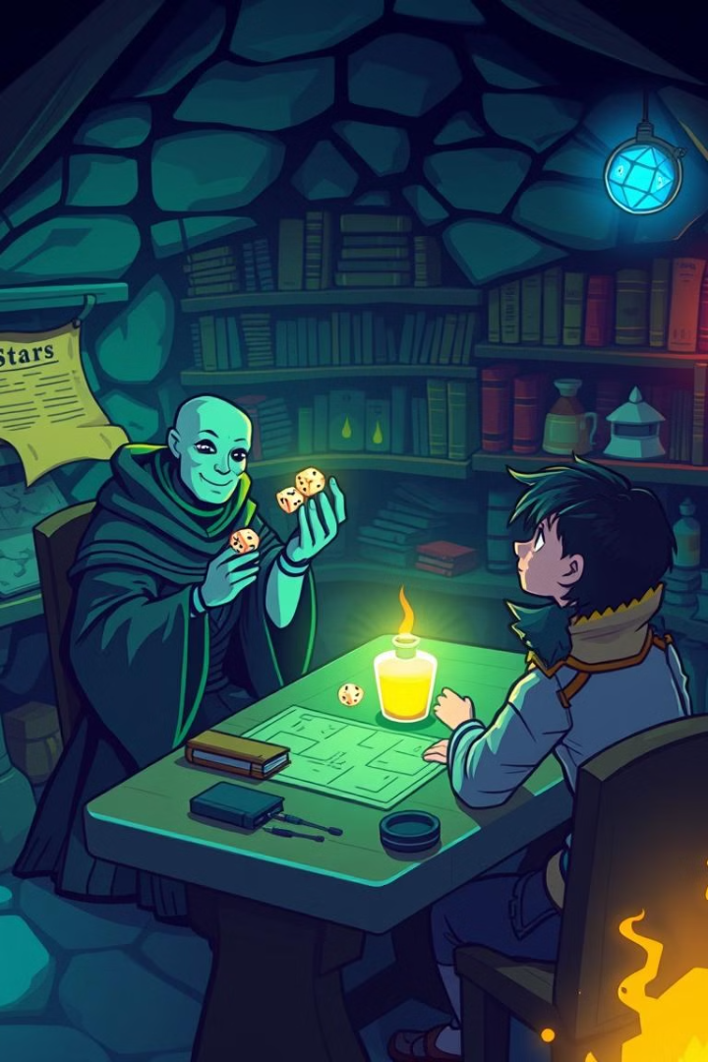
AI Dungeon Master's Role - Staying in Character
Ensuring the AI Stays True to Its Role
The AI functions strictly as a Dungeon Master and does not entertain unrelated or out-of-context inputs.
If a player’s free input is irrelevant to the ongoing story, the AI politely rejects it and encourages the user to stay engaged with the game’s narrative.
Example of Rebuttal Handling:
Player: "I want to buy a spaceship and fly to Mars."
AI: "That’s an ambitious idea, but right now you are deep in a mystical forest. Perhaps you should focus on finding a way out first!
Notes:
9

Slide 11
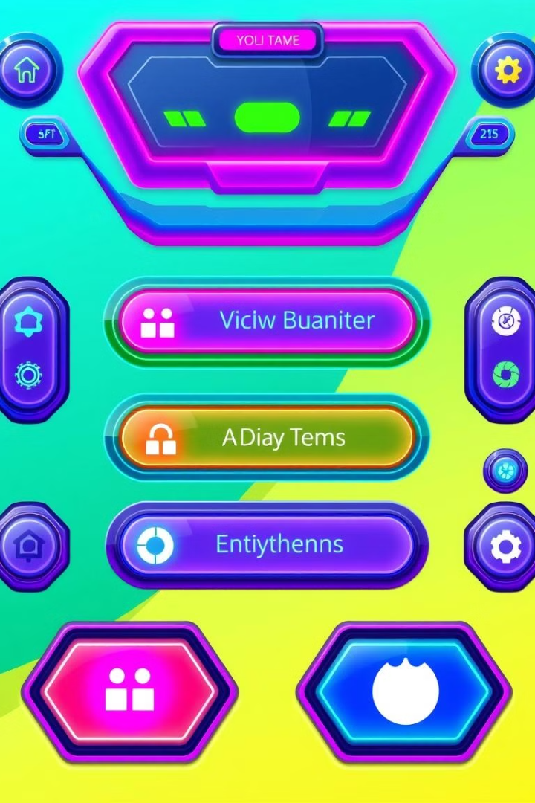
User Interaction:
Dynamic Choices
Interactive Choices
Plot Development
The React frontend renders interactive choices based on LLM-generated options, 3 choices per turn.
User selections drive the story forward, influencing character interactions and plot development in real-time.
Track User references
Integration with analytics tracks user preferences, popular choices, and story paths for personalized recommendations.
Notes:
10

Slide 12


User Interaction: Free Text Input
Custom Actions
Spell Effects
Users can input custom actions and descriptions, enabling the LLM to adapt the story accordingly.
1
For example, typing "I cast a fireball at the dragon" prompts the LLM to respond with the effects of the spell.
2
Notes:
11

Slide 13
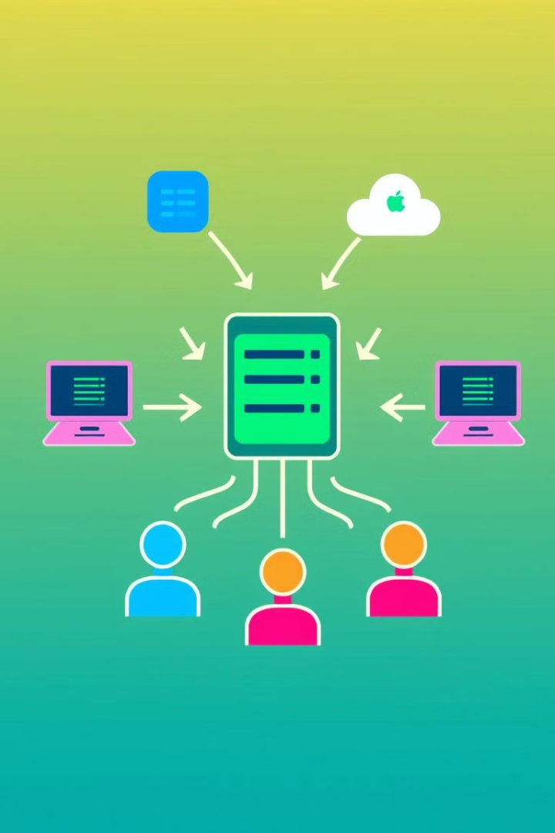
API Communication - React & Flask Integration
Axios API Calls:
Sends choice and addon data to the backend.
Handles API response, extracting the new story and choices.
Real-Time Updates:
Story and choices update dynamically after each response.
Uses useRef to auto-scroll to the latest story segment.
Error Handling:
If the API call fails, an error message is logged and displayed to the user.
Button is disabled while waiting for a response to prevent spam clicks.
Notes:
12

Slide 14
Challenges Faced
1
Memory Retention
2
Structured AI Responses
Addressed effectively with ChromaDB.
Achieved through Regex parsing for story and choice extraction.
3
Unexpected User Input
4
API Rate Limits & Optimization
Politely redirected by the AI to maintain narrative focus.
Enhanced performance through caching and robust error handling.
Notes:
13

Slide 15
Results & Observations
The chatbot successfully generates engaging, interactive stories.
Memory retention enhances continuity in storytelling.
Users enjoy both predefined choices and the flexibility of free input.
The system provides a dynamic experience with smooth UI and real-time updates.
Notes:
14

Slide 16





Conclusion & Future Directions
Voice Interaction
World Generation
Multi-Player
Enhanced Memory
AI Dungeon Master demonstrates the potential of LLMs for storytelling. Future enhancements include voice interaction, procedural world generation, and multi-player support. Join the community to contribute and explore AI-driven narrative experiences.
Notes:
16

Slide 17
References
Google Gemini API Documentation
LangChain & ChromaDB Official Documentation
Flask & React.js
Notes:
17

